Slide 1
New RSV prevention products
the development journey
Updated: January 2024

Slide 2
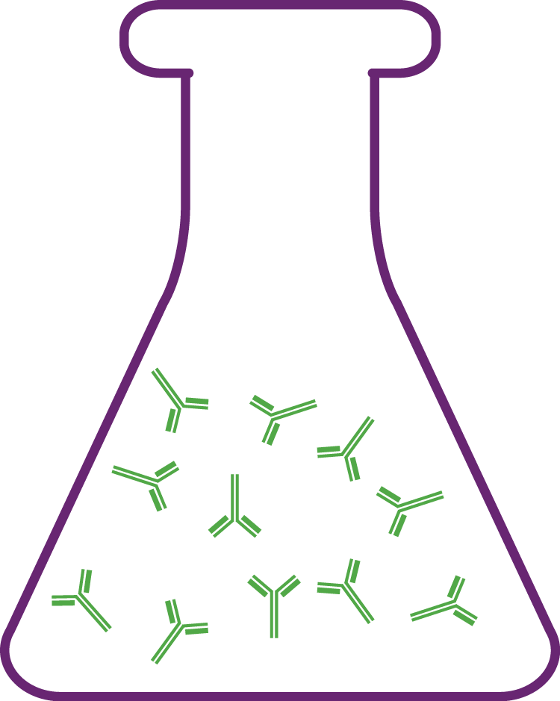
Agenda
 | A history of RSV product development how a scientific breakthrough turned stall into success
 | New RSV maternal vaccine for protecting infants product information and evidence
 | New long-acting RSV monoclonal antibodies given at birth product information and evidence
Notes:
In this presentation, we will talk about the journey scientists took to develop immunization products against RSV, specifically maternal vaccine and long-acting monoclonal antibodies.
We will discuss products administered to pregnant women to prevent RSV in their infants and products given to infants themselves—covering how both work to prevent RSV disease in early life.

Slide 3
A history of RSV product development
how a scientific breakthrough turned stall into success

Slide 4
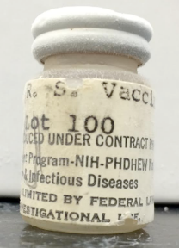
The early days of RSV vaccine development
In the 1960s, direct immunization of children with formalin-inactivated RSV vaccine in clinical trials resulted in enhanced respiratory disease (ERD) upon subsequent natural RSV infection.
The children with ERD experienced an inflammatory immune response that
clogged the lungs.
was not effective at clearing the RSV virus.
led to increased severe disease and hospitalization.
AS A RESULT, RSV VACCINE DEVELOPMENT STALLED FOR DECADES.
We’ve learned a lot since then.
Notes:
Products targeting RSV have been in development for over half a century.
In the 1960s, a clinical trial of a formalin-inactivated RSV vaccine had disastrous results.
The vaccine only elicited relatively weak antibodies and children vaccinated with that vaccine had a paradoxically severe reaction when they experienced their first natural RSV infection after being immunized.
Something called Enhanced Respiratory Disease (ERD) created an effect like a severe allergic reaction in those children’s lungs and they got very sick and there were two deaths.
As a result, RSV vaccine development stalled for many decades as scientists worked to understand what went wrong and how to prevent it in the future.
Science has come a long way since then and new immunization products have emerged that avoid the pitfalls of the 1960s, which we’ll talk about in more depth.

Slide 5
What mattered? Whether a baby already had an RSV infection
0-24 months
RSV naïve → risk of vaccine-induced ERD with direct vaccination
School age children through older adulthood
High likelihood of multiple exposures to RSV → ERD not a risk factor with direct vaccination
Notes:
Scientists have since learned that the prime distinction between individuals experiencing ERD after direct vaccination with the formalin-inactivated RSV vaccine and those who didn’t hinged on whether the individual had ever had a natural infection with RSV before receiving the vaccine.
It was RSV-naive individuals who had not yet had a natural infection with RSV, such as young babies, that were potentially susceptible to ERD when given this formalin-inactivated vaccine.
The antibodies that the infants’ immune system produced did not sufficiently neutralize naturally occurring virus and, in fact, caused the immune system to overreact.
The vaccine development community needed to find a way to protect infants without the risk of ERD.
The solution was passive immunization – transfer of robust protective antibodies to infants, so they don’t have to make their own immune response.
Of note, besides protecting young infants, the other target group for RSV prevention is older adults, who often have underlying health issues that cause RSV to be serious or life-threatening.
But older adults were never at risk of ERD from direct vaccination since they have been exposed to natural RSV infection many times over the course of their lives.

Slide 6
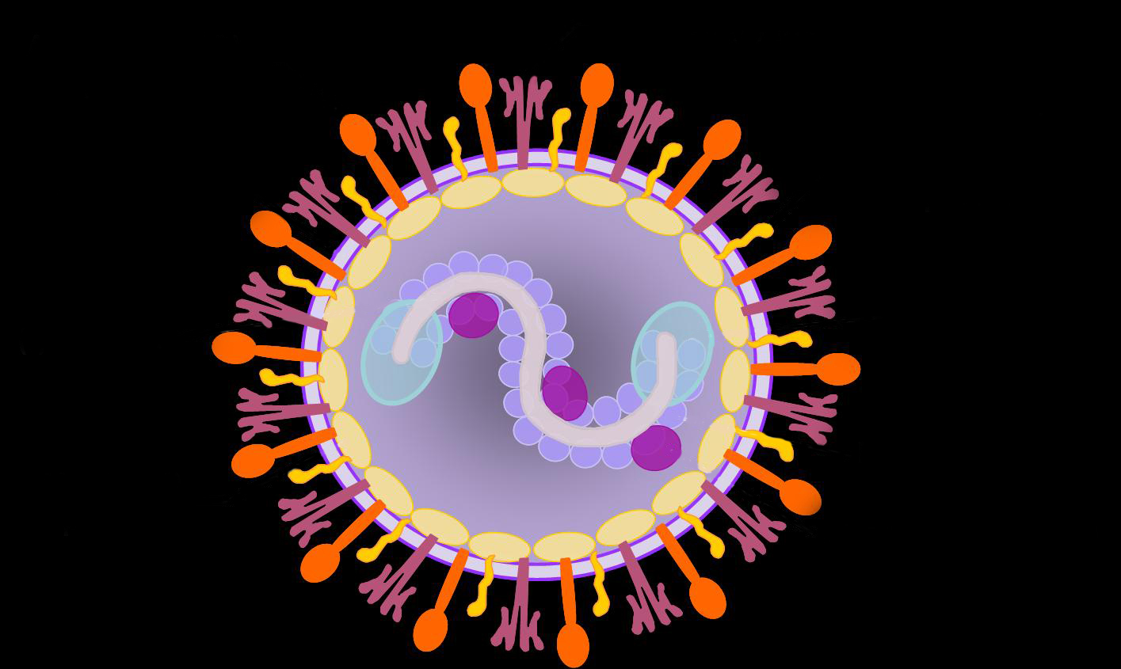
The vaccine immune target: RSV fusion (F) protein
What is the RSV fusion (F) protein?
The part of the virus that fuses to cells in the body, enabling the virus to invade the cells and cause infection.
The opportunity
If a vaccine can help the body create antibodies to the F protein that interrupt this process, disease can be prevented.
The challenge
The RSV F protein is very unstable and undergoes dramatic structural changes between a pre-fusion and post-fusion state, making it a difficult antigen to use in a vaccine.
Fusion (F) protein
Notes:
Besides gaining an understanding of the risk of ERD, the scientific community has learned a lot about the RSV virus itself since the 1960s.
Scientists knew that the most promising part of the virus to target with a vaccine was the fusion (or F) protein, which is a component on the surface of the RSV virus that fuses to host cells, enabling the virus to infect the cell and eventually lead to disease.
Neutralizing the F protein was found to be a key element to preventing infection, but for a long while, scientists didn’t have a detailed enough understanding of the intricate structure of the RSV F protein to develop a vaccine that could induce robust neutralizing antibody responses.
Eventually, though, the science caught up and important structural elements of the F protein became more clear.

Slide 7
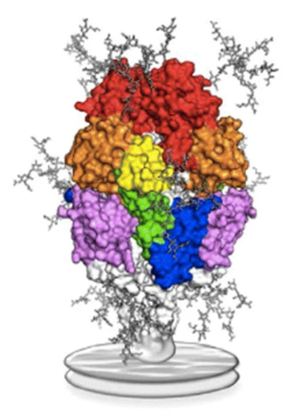
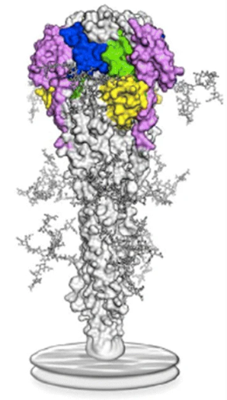
The key scientific breakthrough stabilizing the RSV F protein in a pre-fusion (pre-F) state
Colors represent different neutralizing sites on the F protein
Pre-F displays more, better neutralizing sites than post-F
Vaccines containing stabilized pre-F protein induce robust neutralizing antibodies that protect against disease.
Pre-F
Post-F
Image: Graham B, Current Opinion in Virology. 2017.
Notes:
Some vaccines work by introducing a modified version of a virus protein, or antigen, that prompts the body to develop protective antibodies, without causing disease.
The immune system needs to learn how to create antibodies that can neutralize the active components of the virus so that it can’t cause infection.
In the case of RSV, protection is needed against what’s called the pre-F form of the Fusion protein on the virus, which is the active form of the protein that fuses to cells and results in infection.
The F protein also has another form called post-F, but it is inactive and cannot fuse to cells to cause infection--so is therefore an inferior RSV vaccine antigen.
The difficulty that vaccine developers have historically faced, however, is that the pre-F form is naturally unstable.
To create an effective vaccine, what needed to happen was the difficult job of locking the protein into a pre-F state.
In doing so, vaccination could prompt the immune system to create specifically tailored antibodies in sufficient numbers and strength to neutralize the virus against natural infection.
The breakthrough came in the 2010s when scientists finally discovered how to lock the fusion protein into the pre-F form so it could be used as a vaccine.
Now, inducing robust neutralizing antibodies to protect against RSV disease is possible.
And this success has triggered a cascade of new prevention product development.

Slide 8
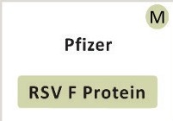
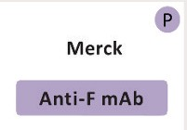
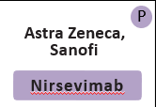
New hope of preventing RSV in infants—a product development renaissance
New pre-F technologies appropriate for protecting infants
Maternal vaccines
Long-acting monoclonal antibodies (mAbs)
Maternal vaccine
licensed in US and Europe
Long-acting mAb in Phase 3
Long-acting mAb licensed in Europe and US
www.path.org/resources/rsv-vaccine-and-mab-snapshot/
Notes:
A development renaissance of RSV prevention products is underway spurred by the pre-F scientific breakthroughs to protect infants, children, and older adults.
New options for protecting infants (beyond the short-acting palivizumab) include a long-lasting monoclonal antibody and a maternal vaccine for delivery in pregnancy—both of which are based on the pre-F technology.
Pfizer has a vaccine given in pregnancy that was recently approved for use in the US and Europe. It is currently on the pathway to being considered for WHO prequalification, which could occur as early as 2024.
AstraZeneca’s long acting mAb, nirsevimab, is licensed in Europe and the US—though this product is expected to require market shaping for global access to be possible.
Other intended populations for vaccines are elderly adults and older infants/toddlers.

Slide 9
RSV disease prevention for young infants
PALIVIZUMAB Short-lasting mAb that can prevent severe RSV in high-risk infants Use is limited to high-income countries Requires up to 5 monthly doses Expensive/ impractical for low- and middle-income markets Neutralizes a single site found on both pre- and post-F proteins NIRSEVIMAB (NEW) Long-acting mAb given at birth or soon thereafter (approved in Europe and US) Price and supply may be early barriers to global access, requiring market shaping to overcome Only 1 dose needed Neutralizes a single site found on pre-F protein only | MATERNAL VACCINE (NEW) Vaccination in pregnancy can prevent RSV disease in infant’s early months of life (approved in US and Europe) Not yet widely available, but intended for the global market Induces neutralizing antibodies to many sites on the pre-F protein
MONOCLONAL ANTIBODY (MAB) PREVENTION
VACCINE PREVENTION
Notes:
Up until recently, the only RSV product licensed was a monoclonal antibody called palivizumab.
Palivizumab targets a single neutralizing site on the fusion protein
It is short acting because the antibody doesn’t include the mutation that extends circulation time in the body, so it requires up to five monthly doses to protect throughout RSV season—an expensive and impractical prospect for most countries.
As such, palivizumab has only been available in high-income markets.
Now, with the knowledge of the importance of the pre-F protein, new RSV immunization products achieve longer-acting protection than what was possible before, including maternal vaccines and longer lasting mAbs.
We’ll explain these in more detail in the next couple of slides.

Slide 10
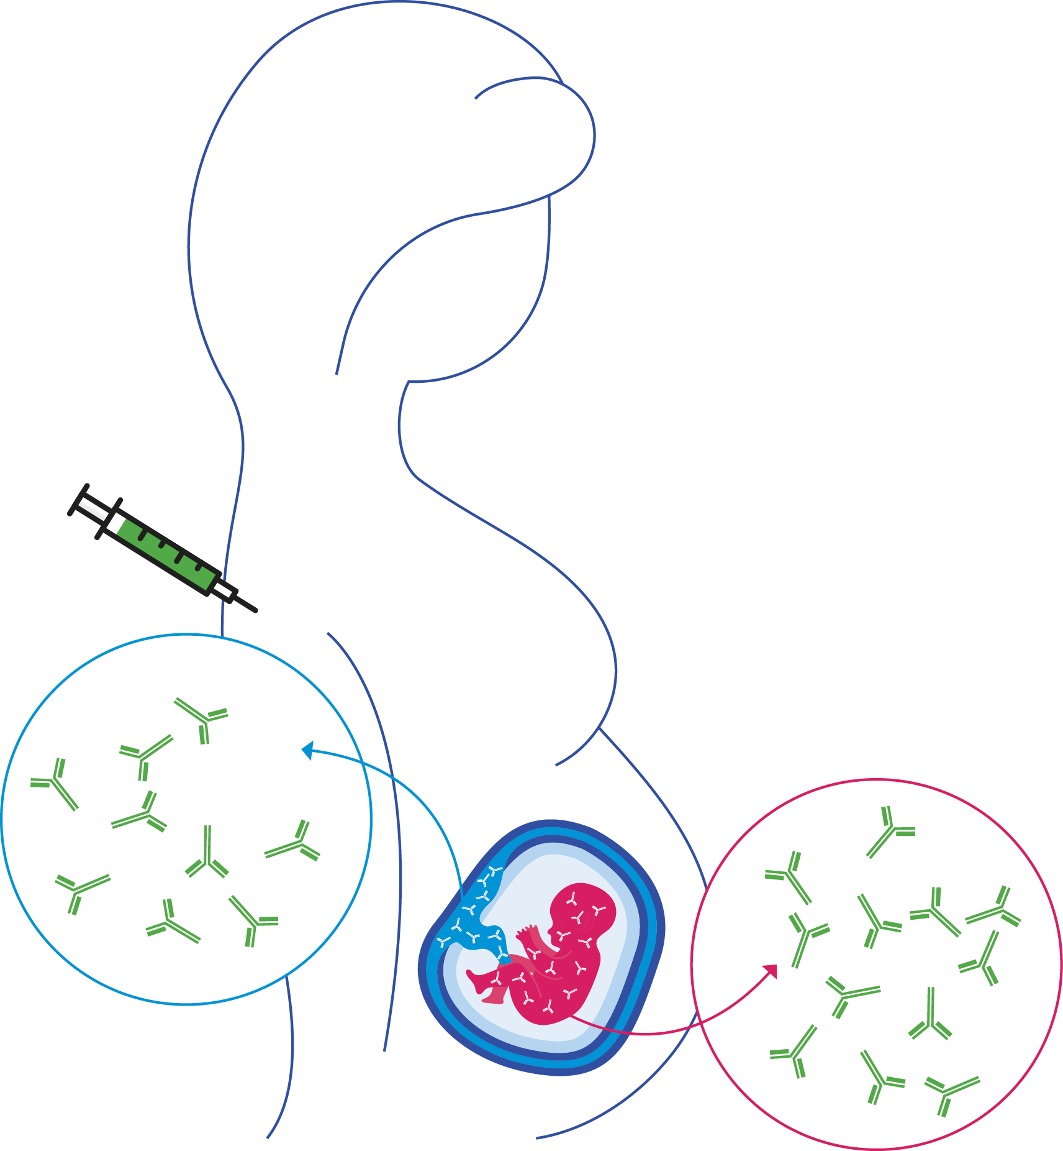
What is a maternal vaccine?
AFTER vaccination
Maternal vaccines are:
given in pregnancy to help protect mother, baby, or both from serious infections.
active immunization for the mother.
passive immunization for the baby because the mother’s antibodies naturally transfer across the placenta to provide protection at birth and for months thereafter.
Why are maternal vaccines needed?
Serious infections can occur when babies are very young and their immune systems are too immature to mount an adequate immune response of their own.
RSV antibodies
Notes:
Maternal immunization is a way to help protect a pregnant woman, her baby, or both from serious infections.
It is a type of active immunization for the mother, because the body makes its own antibodies.
Conversely, maternal immunization is a form of passive immunization for the baby. This means that already formed antibodies are transferred to the individual; in this case, the mother’s antibodies naturally transfer across the placenta to the baby.
With passive immunization, antibody levels are expected to have limited duration because the body is receiving antibodies, not continually making ones itself.
The key for a successful RSV maternal vaccine is to ensure that the maternal antibody levels are robust enough to last through the most critical 6 months after birth when the infants is a greatest risk of severe RSV disease.
Serious infections can occur when babies are very young and their immune systems are too immature or multiple immunizations would be required to mount an adequate active immune response.
[NOTE: Other relevant slides are available in the “Maternal immunization and mAb approaches” deck as part of this toolkit.]

Slide 11
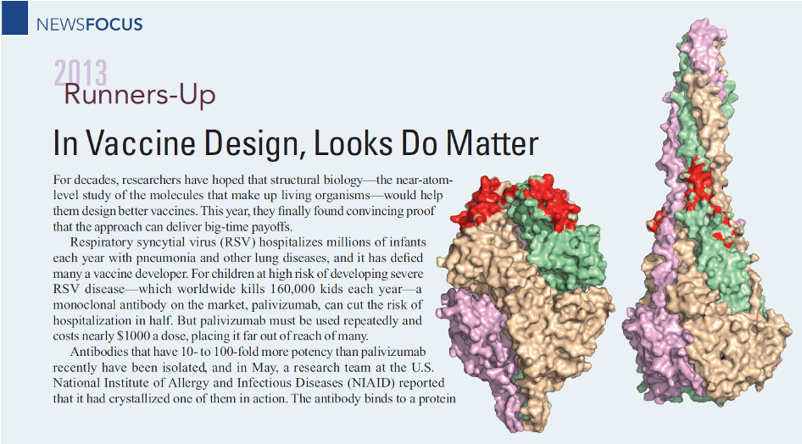
New is not like the old
OLD PRODUCTS
The old 1960s formalin-inactivated RSV vaccine candidate used a post-F antigen, so is a different product than the pre-F immunization products achieving licensure today.
NEW PRODUCTS
New pre-F products offer longer-lasting protection than palivizumab.
RSV pre-F technology receives Science
runner-up technology of the year in 2013
Notes:
To be clear, the new pre-F immunization products and are licensed are NOT the same products as the formalin inactivated vaccine candidate of the 1960s that included predominantly post-F components.
In short, in the pre-F prevention products of today targeting the protection of RSV-naïve individuals, namely infants, the vaccine antigen is locked into a pre-F state, prompting the immune system to create specifically tailored antibodies capable of neutralizing naturally occurring virus.
These products have favorable safety profiles, because the right protective antibodies are transferred to the newborn instead of requiring baby’s immune system to develop them on its own—avoiding the vaccination pitfalls of the 1960s.
This breakthrough made the cover of Science as the runner up scientific breakthrough of the year in 2013.

Slide 12
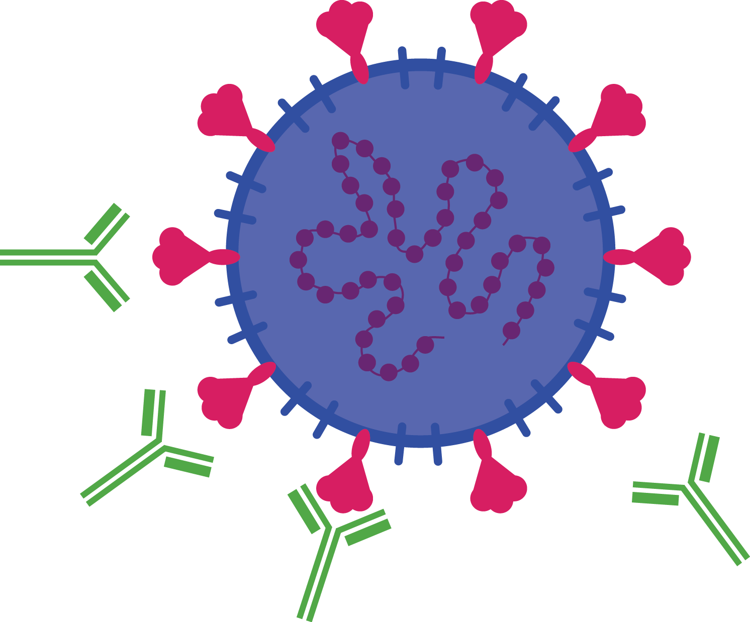
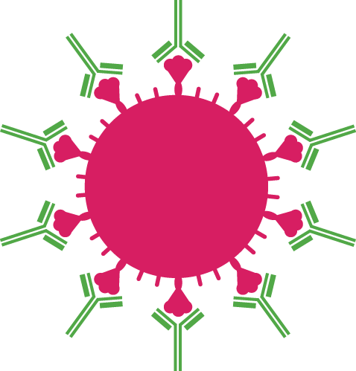
What are mAbs ?
mAbs are:
manufactured antibodies given at birth or soon thereafter that can kill a virus or other pathogen
Protect immediately and don’t require infants to produce their own antibodies
similar to other birth dose vaccines (e.g., hepatitis B, BCG)
Why are mAbs needed?
They provide protection when a newborn's immune system is still too immature to respond to vaccines.
They avoid the need for infants to produce their own antibodies.
mAbs mimic human antibodies but are created in labs and tailored to a specific condition
Like human antibodies, mAbs attach to harmful pathogens and antigens, alerting the immune system to a threat
This immune response helps to neutralize the threat and overcome illness
Notes:
Mimicking the natural antibodies that our immune systems produce, mAbs are antibodies specifically engineered in laboratories to fend off a targeted disease or infection.
MAbs are a form of passive immunization, and offer protection immediately, since they don’t require infants to actively produce their own antibodies.
Like human antibodies, they work by attaching themselves to harmful pathogens and alerting the immune system to the threat, helping neutralize the foreign invader and prevent illness.
Sometimes infections occur when babies are very young, before a vaccine given to a baby would have a chance to work or when a baby’s immune system is too immature to mount a sufficient or safe immune response
mAbs provide the antibodies needed without the baby’s immune system needing to generate antibodies of its own

Slide 13
New RSV maternal vaccine for protecting infants
product information and evidence

Slide 14
Phase 3 clinical study evidence pre-F RSV maternal vaccine efficacy and safety in infants born to women vaccinated during pregnancy
 | Study product: Abrysvo™
 | 7,392 pregnant participants ≤49 years between ≥ 24 and ≤ 36 weeks gestation
 | 7,128 infants enrolled
Study sites in 18 countries
Reference: Kampmann B, et al. New England Journal of Medicine. 288(16):2023.
Original slide developed by the World Health Organization and PATH. Last updated: January 2024.
Notes:
MATISSE was a randomized, double-blinded, placebo-controlled phase III study designed to assess the efficacy, safety, and immunogenicity of RSVpreF against medically-addended lower respiratory tract infection (MA-LRTI) and severe MA-LRTI in infants born to healthy women vaccinated during pregnancy.
The study enrolled around 7,400 pregnant women.
Pregnant women aged 49 years or younger were randomized in a 1:1 ratio to receive a single dose of either Pfizer’s RSVpreF or placebo during the late second to third trimester of their pregnancy.
The trial also evaluated safety throughout the study and immunogenicity of the vaccine in pregnant women and their infants.
The women were followed for safety through vaccination and for 6 months after delivery.
Their infants were followed for at least 1 year for safety and efficacy, with over one-half of the infants followed for 2 years.
This was a global study in 18 countries starting in June 2020, so it spanned multiple RSV seasons in both the northern and southern hemisphere.

Slide 15
Pre-F RSV maternal vaccine efficacious against severe medically attended RSV in infants
EFFICACY (%)
FROM BIRTH THROUGH 90 DAYS
(CONFIDENCE INTERVAL)
EFFICACY (%)
FROM BIRTH THROUGH 180 DAYS (CONFIDENCE INTERVAL)
Severe medically attended RSV-LRTI | (95% CI, 40.6% to 96.3%) | (95% CI, 44.3% to 84.1%)
Medically attended RSV-LRTI | (95% CI, 14.7 to 79.8) *did not reach pre-specified level of statistical significance | (95% CI, 29.4% to 66.8%)
81.8%
69.4%
57.1%*
51.3%
Efficacy remains high through first, most critical 6 months after birth—
when infants are at greatest risk.
Reference: Kampmann B, et al. New England Journal of Medicine. 288(16):2023.
Notes:
Pfizer’s maternal vaccine demonstrated positive safety and efficacy results in Phase 3 clinical evaluation and was approved in Europe and the United States in 2023.
Notably, the Phase 3 trial infant data showed the vaccine’s efficacy against severe medically attended lower-respiratory tract infection to be around 82% in the first 3 months after birth and 69% 6 months after birth.
These results show that the vaccine is able to provide protection to infants against severe RSV disease during the highest period of risk.
Given the high burden of RSV and that the virus is so widespread, such efficacy means that a large number of cases could be prevented, promising high potential for impact.
To ensure that this product can be eligible for global procurement and made widely available, an important next step now is to accelerate the pathway to WHO prequalification.
The earliest it could be prequalified is 2024.

Slide 16
New RSV maternal vaccine licensed to protect infants
 | Pfizer, Inc. (Abrysvo™)
 | in Europe (August 2023) | in the US (August 2023)
 | For immunization of pregnant individuals to help protect their infants from birth through 6 months of age from lower respiratory tract disease due to RSV Vaccination likely needed with each pregnancy
 | 24-36 weeks (Europe) | 32-36 weeks (US)
 | For intramuscular injection Uses standard cold chain Lyophilized (freeze-dried) prefilled syringe; single-dose vial / multi-dose vial presentation in development Can be co-administered with other maternal vaccines
DEVELOPED BY
APPROVAL
MATERNAL IMMUNIZATION INDICATION
APPROVED GESTATIONAL
AGE WINDOWS
ABOUT THE
PRODUCT
Original slide developed by the World Health Organization and PATH. Last updated: January 2024.
Notes:
Developed by Pfizer, Inc. (Abrysvo®).
Approved in Europe and US (August 2023)
Indicated for immunization of pregnant individuals to help protect their infants from birth through six months of age from lower respiratory tract disease due to RSV.
Approved gestational age windows → 24-36 weeks (Europe); 32-36 weeks (US)
For PAHO countries electing to introduce maternal RSV vaccine, PAHO recommends its use in pregnant women at 32-36 weeks of gestation.
WHO prequalification possible as early as 2024.

Slide 17
RSV maternal vaccine approved based on efficacy and safety data
US Food and Drug Administration (FDA) and European Medicines Agency (August 2023).
Vaccine effective in preventing severe RSV disease.
Overall Benefit:Risk balance is favorable.
In Phase 3 trials, numerical imbalances with more premature births in the vaccine group compared to placebo group were observed in several countries, although were not statistically significant overall.
Post market authorization studies will gather additional vaccine safety and effectiveness data.
Regulatory authority approvals support that vaccine
benefits outweigh potential risks.
Original slide developed by the World Health Organization and PATH. Last updated: January 2024.
Notes:
Pfizer has reported that the RSVpreF maternal vaccine had a positive safety profile in clinical trials with no statistically significant safety concerns.
The vaccine has a normal side effect profile similar to many other vaccines in widespread use, including pain at the injection site and fatigue.
The overall Risk:Benefit balance is favorable.
Some imbalances in prematurity between vaccine and placebo groups in several countries were observed in Phase 3 clinical evaluation but were not statistically significant overall.
No increase in deaths was seen with prematurity, and data were insufficient to indicate a causal relationship between vaccination and prematurity.
Based on the efficacy and safety data, the US Food and Drug Administration (FDA) and the European Medicines Agency (EMA) voted to approve the vaccine for use in pregnancy.
EMA approved the full 24-36-week gestational age window.
The US FDA recommended the later gestational age vaccination window of 32-36 weeks to minimize the theoretical risk of preterm birth.
PAHO recommends the 32-36-week window for member countries electing to introduce the maternal RSV vaccine.
Post market authorization studies will be conducted to continue gathering safety and performance data, including birth outcomes, vaccine effectiveness, and other measures.
Overall, regulatory authority approval decisions support that the vaccine’s benefits outweigh potential risks.
The same vaccine is also approved for older adults 60 years and older in US and Europe.

Slide 18
Will RSV pre-F maternal vaccine be available for low- and middle-income markets and when?
Pfizer maternal vaccine
2023
2024
2025
2026
FDA filings
EMA filings
FDA & EMA approved
Earliest possible
SAGE
review
Earliest PQ single-dose maternal vaccine
Earliest PQ multi-dose vial maternal vaccine
EMA=European Medicines Agency
FDA=US Food and Drug Administration
SAGE=WHO Scientific Advisory Group of Experts
PQ=WHO prequalification
Development of an affordable multi-dose vial presentation is underway to
support delivery in low- and middle-income economies.
Notes:
As you can see, the final stages of development are happening now, and there may be a globally accessible maternal vaccine WHO prequalified by as early as 2024.
Furthermore, a Bill & Melinda Gates Foundation grant to Pfizer is supporting the development of an affordable multidose vial for delivery of its RSV maternal vaccine for lower-income countries via public sector purchasers, including Gavi, the Vaccine Alliance.
Currently, products are in single-dose, pre-filled syringes, however multi-dose vials could reduce the cost of the vaccine, making it more appropriate for lower income settings
This progress is reason to get excited, but also to get moving on preparations for putting these products to lifesaving use in places that need them the most.

Slide 19
New long-acting RSV monoclonal antibodies given at birth
product information and evidence

Slide 20
Assessing long-acting mAb efficacy and safety in infants Phase 3 clinical study (MELODY)
160 sites across 29 countries
Study product: nirsevimab (AstraZeneca / Sanofi Pasteur)
Randomized, double-blind, placebo-controlled study
3,012 healthy infant participants born at term or late preterm (gestational age ≥ 35 weeks)
Reference: Muller WJ, et al. NEJM. 2023.
Original slide developed by the World Health Organization and PATH. Last updated: January 2024.
Notes:
The phase 3 MELODY study was a randomized, double-blind, placebo-controlled trials designed to assess the efficacy and safety of nirsevimab for preventing RSV-associated LRTI in healthy infants.

Slide 21
Long-acting pre-F mAb (nirsevimab) Phase 3 efficacy results
EFFICACY (%)
(CONFIDENCE INTERVAL)
OUTCOME MEASURED
(95% CI, 48.8 to 91.0) | Very severe medically attended RSV-associated lower respiratory tract infection (LRTI) through 150 days after injection
(95% CI, 62.3 to 85.2) | Medically attended RSV-associated LRTI through 150 days after injection
(95% CI, 49.4 to 89.4) | Hospitalization for RSV-associated LRTI through 150 days after injection
78.6%
76.4%
76.8%
Efficacy remains high through 5 months after administration—
when infants are at greatest risk.
Reference: Muller WJ, et al. NEJM. 2023.
Notes:
The first new long-acting mAb out of the pipeline is Astra Zeneca and Sanofi Pasteur’s nirsevimab, approved in Europe and the United States.
Phase 3 clinical trial infant data showed the vaccine’s efficacy over the first 150 days to be 78.6% for medically attended LRTI and 76.8% for medically attended LRTI with hospitalization.

Slide 22
New long-acting RSV mAb (nirsevimab) given to newborns and young infants
 | AstraZeneca and Sanofi (Beyfortus®)
 | in Europe (November 2022) | in the US (July 2023)
 | For prevention of serious lower respiratory tract disease due to RSV in newborns and infants during their first RSV season US approval goes up to 24 months of age for children who remain vulnerable to RSV disease entering their second RSV season.
 | Sterile liquid / pre-filled syringe 50 mg (0.5 mL) for infants <5 kg or 100 mg (1.0 mL) dose for infants ≥5 kg. Intramuscular injection in thigh, similar to a vaccine. Given at birth or as soon as possible; can be given with other infant vaccines.
DEVELOPED BY
LICENSED
INDICATION
ABOUT THE
PRODUCT
Reference: Sanofi web page. “Beyfortus™: Dosing and Administration.”Accessed on December 15, 2023.
Original slide developed by the World Health Organization and PATH. Last updated: January 2024.
Notes:
- AstraZeneca and Sanofi’s long-acting RSV mAb was approved in Europe in November 2022 and the US in July 2023.
- It is indicated to be given by direct injection to newborns and infants during their first RSV season. In the US, approval goes up to 24 months of age through a child’s second RSV season.

Slide 23
RSV long-acting mAb approved based on safety and efficacy data
European Medicines Agency approved in November 2022.
US Food and Drug Administration approved in July 2023.
No safety concerns reported.
Post market authorization studies required to gather additional vaccine safety and effectiveness data.
Regulatory authority approvals support that mAb (nirsevimab) benefits outweigh potential risks.
Notes:
Sanofi and AstraZeneca has reported that the long-acting RSV mAb (nirsevimab) had a positive safety profile in clinical trials with no safety concerns.
The mAb has a normal side effect profile similar to many other vaccines in widespread use.
Based on the efficacy and safety data, the US Food and Drug Administration and the European Medicines Agency voted to approve the vaccine for use in newborns and young infants.
Overall, regulatory authority approval decisions support that the vaccine’s benefits outweigh potential risks.

Slide 24
Long-acting mAb development, approvals, and market entry status
MONOCLONAL ANTIBODIES
2022
2023
2024
2025
AstraZeneca/Sanofi nirsevimab
EMA
approval
FDA
approval
Earliest possible SAGE
review / PQ submission unknown
Merck mAb
Phase 3 completed
FDA
decisions
Earliest possible SAGE/PQ
EMA=European Medicines Agency
FDA=US Food and Drug Administration
SAGE=WHO Scientific Advisory Group of Experts PQ=WHO prequalification
Nirsevimab is not expected to be globally accessible in the near term due to price and supply barriers.
HOWEVER
It sets the stage for other RSV long-acting mAbs becoming more widely available in the future (e.g., Merck).
Notes:
As you can see, the final stages of development are happening now, and there may be a globally accessible maternal vaccine and mAb WHO prequalified by as early as 2024 and 2025, respectively.
This progress is reason to get excited, but also to get moving on preparations for putting these products to lifesaving use.
For nirsevimab, it is not yet clear if the company will submit this product for WHO prequalification, so this metric is not on the timeline at this time.
Although this product is not expected to be globally accessible in the near term due to price and supply barriers; it sets the stage for long-acting mAbs becoming more widely available in the future.

Slide 25
Both products protect infants via passive immunization, but have differences
 | Maternal vaccine | Long-acting mAb
 | Maternal antibodies protect infant in the first 6 months after birth. | mAbs protect for at least 5 months after administration, whenever given.
 | Given to pregnant women Induces antibodies against multiple neutralizing sites on the Fusion protein in the mother and passed to infant. Much less likely that a virus mutation would render induced antibodies ineffective. | Given to infants at birth or as soon as possible Antibodies against a single potent neutralizing site on the Fusion protein. A virus mutation could render the antibody ineffective.
 | Gavi plans to support a maternal RSV vaccine for eligible countries.* A pricing agreement** on multidose vial can make RSV maternal vaccine more accessible for GAVI-eligible countries. | Gavi plans to support a long-acting mAb when an affordable product is available for eligible countries.*
 | Earliest availability in low- and middle-income settings likely in 2025. | Uncertain timing of availability in low- and middle-income settings due to price and supply barriers.
PROTECTION
HOW IT WORKS
COST
AVAILABILITY
*Gavi, the Vaccine Alliance. Review of Decisions: Board Meeting, 28-29 November 2018. Geneva, Switzerland. Accessed at: https://www.gavi.org/sites/default/files/board/minutes/2018/Board-2018-Mtg-2-Review%20of%20Decisions.pdf
** Media center announcement accessed at: https://www.gatesfoundation.org/ideas/media-center/press-releases/2022/09/gates-foundation-announces-grants-to-reduce-infant-mortality
Notes:
Both products avoid the safety pitfalls of previous vaccine candidates in the 1960s because they provide protection through passive immunization and don’t require an active immune response from the infant.
The pre-F maternal vaccine induces antibodies against many neutralizing sites and is, therefore, less susceptible to virus mutations rendering it ineffective.
Pre-F long-acting mAbs, on the other hand, work against a single neutralizing site on the virus, meaning they could be rendered ineffective if the virus mutates.
Also, maternal antibodies protect in the first 6 months after birth, while mAbs protect for 6 months after administration, whenever given. So, there could be slight differences in the age ranges of protection.

